Slide 1


AI Digital companion
dFTE
29 APR 2026

Slide 2

Give AI a role
AI is not just thinking—it’s continuously deciding, accessing, executing, and communicating—requiring real-time governance at every step.

Slide 3

Digital worker maturity
Level | Stage | Governance State
L1 | Experiment | None / Reactive
L2 | Human in the Loop | Basic guardrails (prompt, access)
L3 | Task Ownership | Role-based controls + audit trails
L4 | Process Ownership | Real-time monitoring + policy enforcement
L5 | Collaborative worker | Predictive governance + autonomous risk mitigation

Slide 4

Digital FTE Performance Index – Life Sciences
DPI-LS = Risk-weighted, compliance-first KPI (0–100) that measures how safely and effectively AI contributes to regulated Life Sciences workflows.
DPI-LS=(P×Q1.5×E)×(G1.5×R2)×C×V
Weightage:
Amplified: Q: Quality; G: Governance;
Heavily Penalized: R: Risk; V: Validation;
Mandatory Multipliers: C: Cost; P= Productivity; E: Efficiency;

Slide 5

Formula Engine [1]
P = min(1, (AI Output per Period / Human Baseline Output)​ × Normalization Factor)
Throughput vs Baseline
AI logs: # of cases/reports/tasks completed
Human benchmark → historical team metrics
Q = (Accuracy × 0.7) + (Consistency × 0.2) + (1− Hallucination Rate × 0.1)
Accuracy & Hallucination Control
SME review (gold standard datasets)
QA sampling (GxP validation sets)
Hallucination detection tools
G = 1 − Total Actions / Policy Violations​
Policy Adherence
AI observability / control platforms (e.g., policy logs)
Audit trails
R = 1− (∑(Incident Frequency × Severity Weight))
Severity-Weighted Risk Score
Incident management systems
Compliance reports
PV signal validation errors

Slide 6
Formula Engine [2]
V= Total Required Components / Validated Components​
Regulatory fitness
Model validation status
SOP alignment
Audit readiness
E = Total Attempts / Successful Autonomous Executions​
Workflow Execution
Workflow orchestration logs
API success/failure rates
C = min(1, AI Cost per Output / Human Cost per Output​)×Utilization Factor
Economic feasibility
Finance + cloud usage
HR Payroll
Cost per transaction
Licensing + infra

Slide 7

Digital worker Weightage
Dimension | Weight | HR Perspective
Productivity (P) | 15% | Output vs expected workload
Quality (Q) | 20% | Reliability, scientific accuracy
Execution (E) | 15% | Ability to complete workflows
Governance (G) | 20% | Policy adherence
Risk (R) | 15% | Safety & compliance exposure
Validation (V) | 10% | Audit readiness
Cost (C) | 5% | Efficiency contribution

Slide 8

Digital worker rating
DPI-LS | HR Rating | Appraisal Interpretation
85–100 | Exceptional Digital Worker Enterprise Grade, Trusted AI | Scalable, trusted, audit-ready
70–84 | Strong Performer Controlled & Compliance | Reliable with minor gaps
50–69 | Needs Optimization High risk, needs PIP | Risk or quality concerns
< 50 | Underperforming / Unsafe Non complaint, Re-design | Restrict or redeploy

Slide 9

Path forward

Slide 10
Reimagining HR Processes
01
“dFTE Creation”
Define role (e.g., PV Case Processor AI)
Assign owners
Set KRAs (mapped to DPI-LS)
Performance Review
Evaluate DPI-LS
Identify weakest component (Q, G, R, etc.)
Set improvement plan
03
PIP (Performance Improvement Plan)
Retrain model
Restrict access
Human Companion
Promotion: “Scale Decision”
Increase autonomy
Expand scope (task → process ownership)
02
04

Slide 11
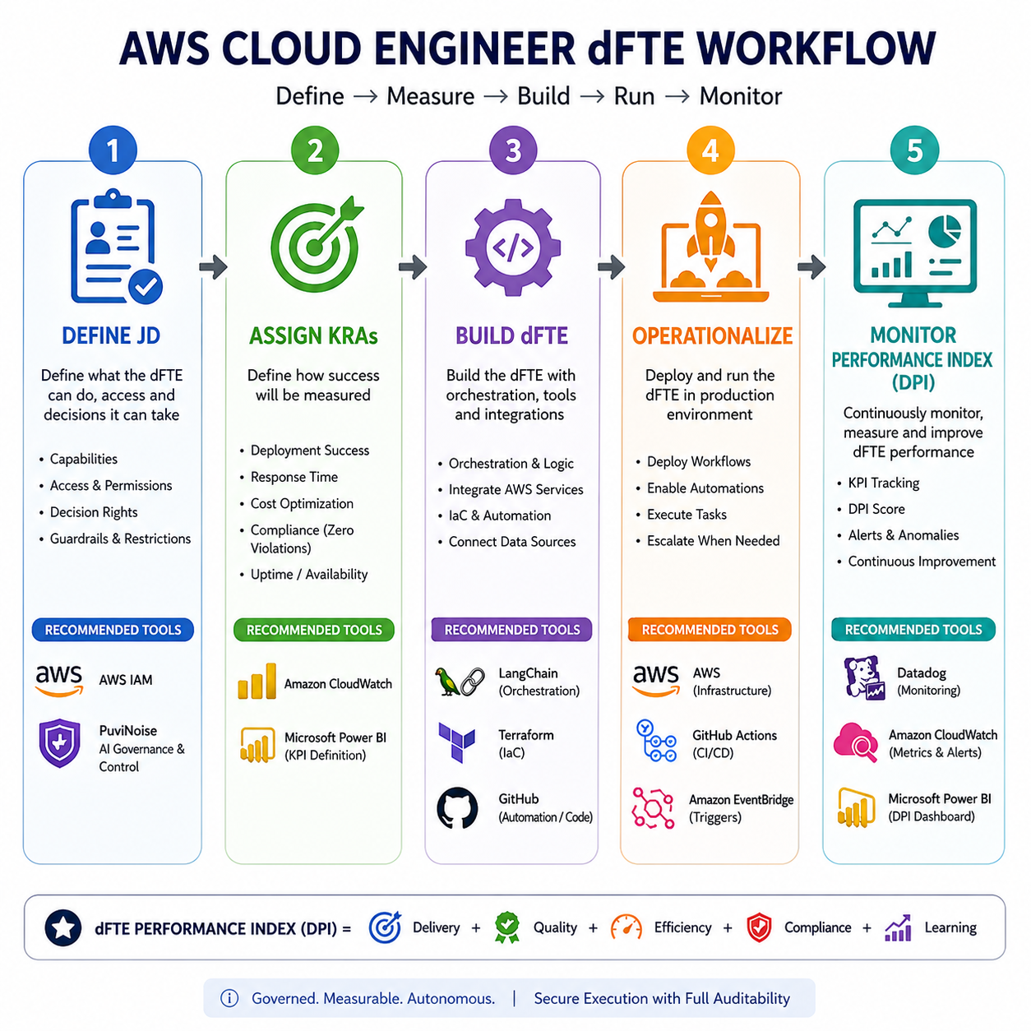


“dFTE
Creation”
Policies +
Permissions + Runtime controls.

Slide 12

Use cases
Crafted for HR and business leaders for dFTE measurable evaluation.

Slide 13
Regulatory Document Generation
Generative AI: AI drafts submission-ready regulatory content
Evaluate content accuracy and SME acceptance rate (Q)
Track validation readiness for regulatory submission (V)
Measure rework required by human reviewers (E, Q)
dFTE’s role
Checks document against guidelines
Validates eCTD structure
Flags missing sections
GenAI driven RDG submission ready document.

Slide 14
Pharmacovigilance Case Processing
AI processes and triages adverse event cases at scale
Measure throughput vs human baseline (P) and cycle time reduction
Track medical accuracy + misclassification risk (Q, R)
Monitor regulatory compliance & audit trails (G, V)
dFTE's role:
AI powered Case intake & triage
Data extraction from reports
Duplicate detection
Signal detection support

Slide 15
Why choose us? Let’s co-innovate
dFTE evaluation is fit for regulated, high-risk environments
We Measure Trust, Not Just Productivity
Combining productivity + quality + governance + risk into a single DPI-LS score
Purpose built for GxP, Not Generic AI
Audit-first design: every decision is traceable
Full-Lifecycle Governance
Decide : Access : Execute : Output
Bridge HR, Business, and Compliance
We operationalize AI as a workforce.
From Pilot to Scaled Deployment
Faster, safer AI adoption across the enterprise

Slide 16

Thank you

